Slide 1
The Impact of Population Growth on Economic Development: An Empirical Analysis
Course project
ECO342A: Econometric Ⅱ Submitted by : Aniket Gautam (200123)

Slide 2
Conclusion:
In conclusion, this research proposal outlines an empirical analysis of the impact of population growth on economic development. The study will use statistical analysis to investigate the relationship between population growth and economic development while taking into account other factors that may affect the relationship. The findings of the study will have important implications for economic policy and future research, providing valuable insights into the relationship between population growth and economic development.

Slide 3
Introduction:
Population growth is a critical issue for economic development, as it affects the availability of resources, labor supply, and demand for goods and services. This research proposal aims to investigate the relationship between population growth and economic development using statistical analysis. Specifically, the study will explore whether population growth has a positive or negative effect on economic development, taking into account other factors that may affect the relationship.

Slide 4
Literature review
Some studies argue that population growth can have a positive impact on economic development. One possible explanation for this is the demographic dividend theory, which suggests that population growth can lead to a larger workforce and increased productivity, resulting in economic growth. According to the theory, if the right policies are put in place, a growing population can contribute to economic development by increasing demand for goods and services and stimulating technological advancements.
Other studies, however, take a negative view of the relationship between population growth and economic development. According to these studies, population growth can lead to a decline in economic development due to limited resources, such as land, water, and food. Additionally, a rapidly growing population can create high levels of unemployment, poverty, and social instability, which can hinder economic development.
Other studies present a mixed view of the relationship between population growth and economic development. These studies suggest that the impact of population growth on economic development depends on a range of factors, such as government policies, cultural factors, and technological advancements. For example, some studies suggest that population growth can lead to greater investment in education and health, which can increase human capital and contribute to economic development.

Slide 5
Research Questions:
1. What is the relationship between population growth and economic development?
2. How do other factors, such as government policies, technology, and cultural factors, affect the relationship between population growth and economic development?
3. What are the implications of the findings for economic policy and future research?

Slide 6
Methodology
The study will use a quantitative research approach, specifically an empirical analysis. The analysis will be conducted using data from reputable sources on population growth and economic development indicators, such as GDP, income per capita, and poverty rates. The study will employ a statistical model, such as regression analysis, time series analysis, to estimate the relationship between population growth and economic development while controlling for other factors that may affect the relationship. Yg = 𝛃0+ 𝛃1*POPg + 𝛃2*INVg + 𝛃3*FDIg + 𝛃4*EXg + 𝛃5*GEg + 𝛃6Cg + μ
Yg = real GDP growth POPg = population growth INVg = real gross domestic investment growth FDIg = real foreign investment growth EXg = Exports growth GEg = Government expenditure Cg = consumption as percentage of GDP μ = error

Slide 7
Expected Results:
The results of the analysis are expected to show the magnitude and statistical significance of the relationship between population growth and economic development. The direction of the relationship (positive or negative) will also be considered. The study will also examine the role of other factors, such as government policies, technology, and cultural factors, in affecting the relationship.

Slide 8
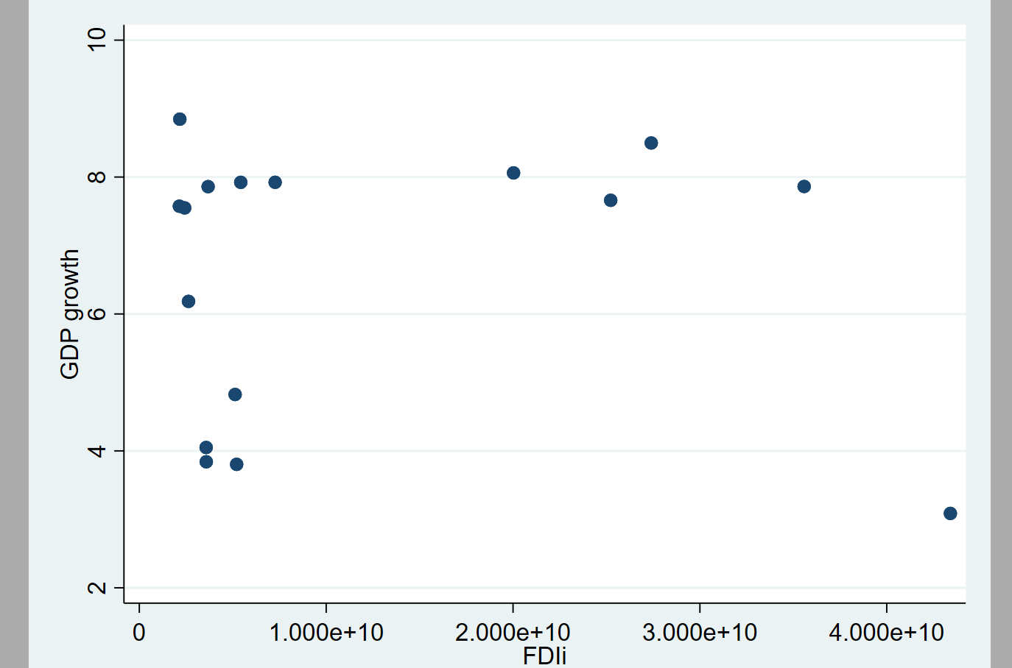

Slide 9
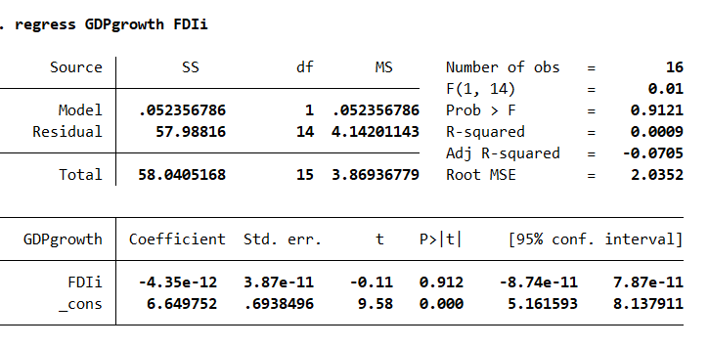

Slide 10
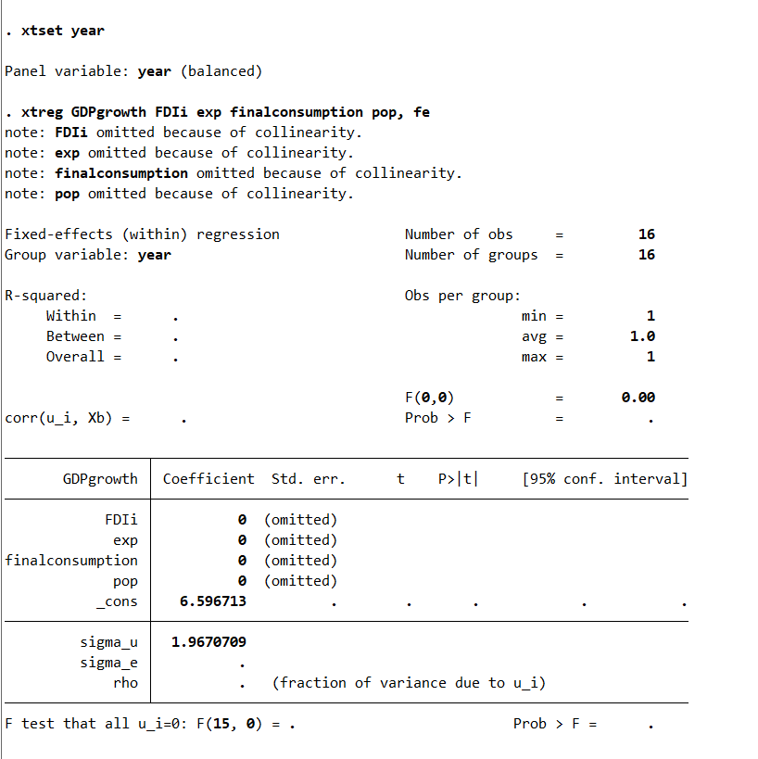

Slide 11
codes
summarize year pop GDPgrowth FDIi exp finalconsumption
scatter GDPgrowth FDIi
regress GDPgrowth FDIi
xtset year
xtreg GDPgrowth FDIi exp finalconsumption pop, fe

Slide 12

Plagiarism Report

Slide 13
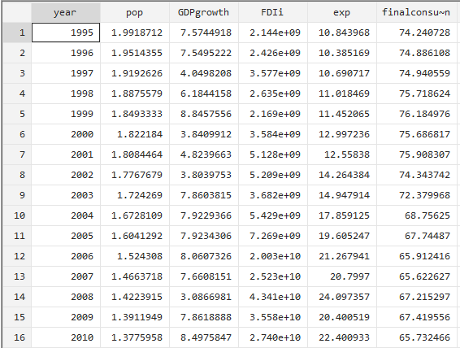
Data

Slide 14
sources
World bank
IMF

Slide 15
Implications:
The findings of the study will have important implications for economic policy and future research. The study will provide valuable insights into the complex and multifaceted relationship between population growth and economic development. The study will also offer recommendations for policymakers on how to manage population growth in ways that promote economic development

Slide 16
Reference
[1] Afzal M. Causality between exports, world income and economic growth in Pakistan. Int Eco J 2006; 20: 63-77. [2] Afzal M. Estimating saving and investment functions in Pakistan. Philip Rev Eco 2004; 41: 67-78. [3] Ali SS, Tahir S. Dynamics of growth, poverty and inequality in Pakistan. Pak Dev Rev 1999; 38: 837-58. [4] Bangladesh Economic Review, Ministry of Finance, Government Republic of Bangladesh-2014. [5] Basak, J.K. 2009. Effects of Increasing Temperature and Population Growth on Rice Production in Bangladesh: Implications for Food Security. Published by Unnayan Onneshan-The Innovators Dhaka, Bangladesh. [6] Bhatti, Ali M, Haque R, Javed T, A sectoral analysis of poverty in Pakistan. Pak Dev Rev 1999; 38: 859-72.

